Slide 1

Front Desk
Training
1.0

Slide 2
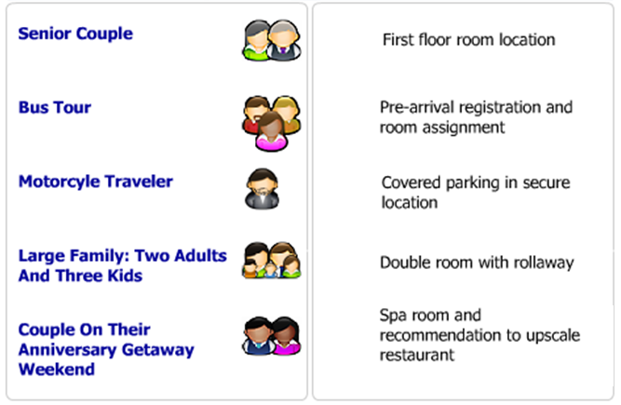
Anticipating Guest Needs

Slide 3
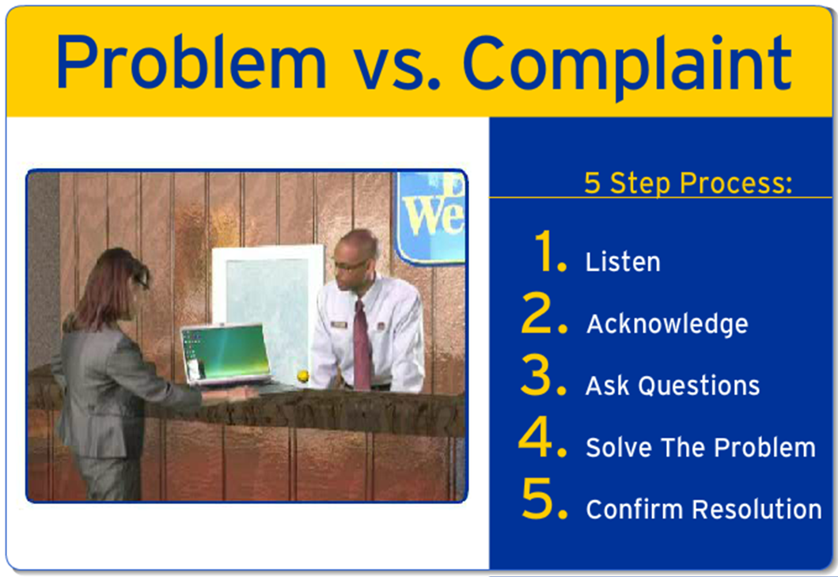
Problem vs. Complaint

Slide 4
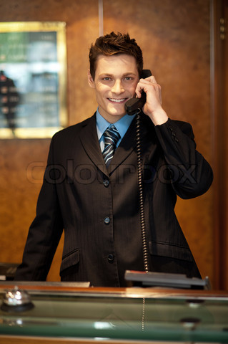
Signature Calls
10 Keys to a Great Call
Answer in 3 Rings
Approved Greeting
Match Day with Date
Quality Caller
Stayed Before?
4 Benefits before Rates
Up Sell Higher Rate
Ask to Confirm
Resistance Question
Thank you!

Slide 5
Front Desk
Training
2.0

Slide 6
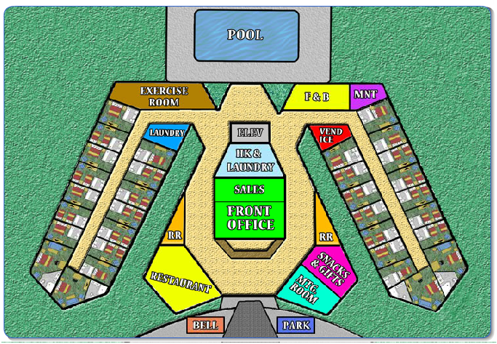
Knowing the Property

Slide 7



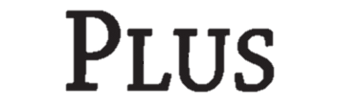
Best Western Brand Overview

Slide 8


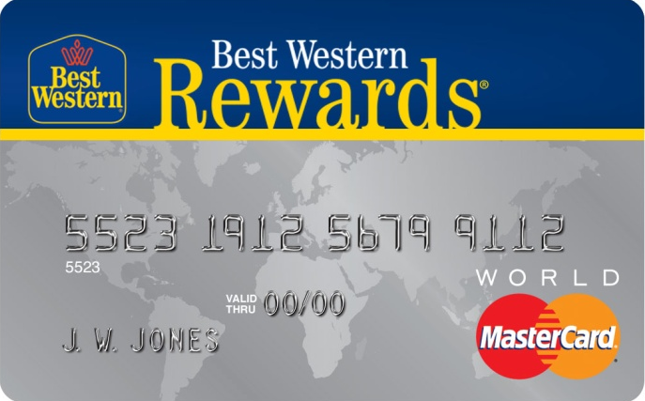


Best Western Rewards

