Slide 1
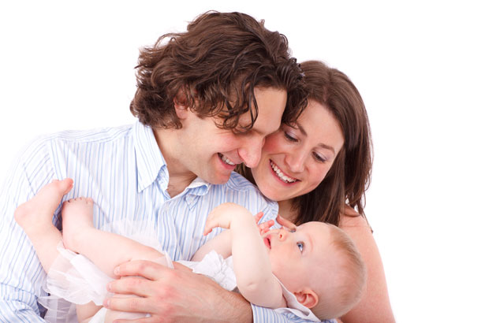
Becoming A Parent
By: Lidia Hernandez

Slide 2
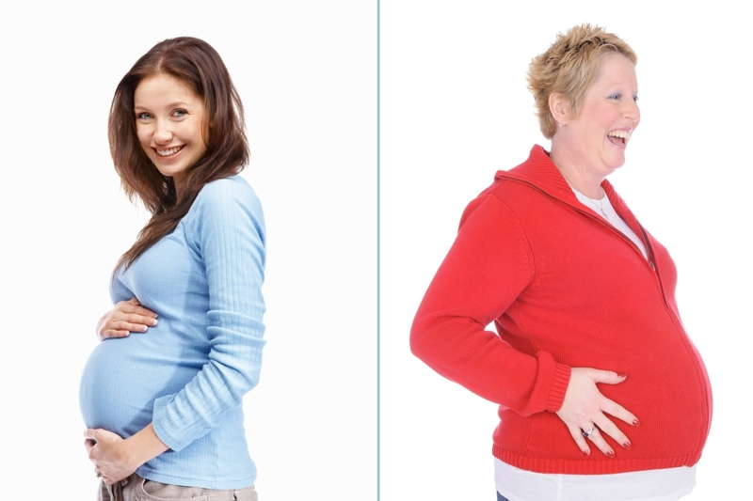
Research indicates that couples are choosing to have children later in life.
Disadvantages
Advantages
Its harder to get pregnant the longer you wait.
Its also harder to stay pregnant.
You will have to work at an older age.
The older you are the less you will see your child and there generations.
The baby might have more health issues.
You’ve had time to grow and see the world.
Your financially more secured.
Your more comfortable in your career.
Your partner and you have had time to know each other in a variety of situations.
You have solid foundations to raise a family.

Slide 3
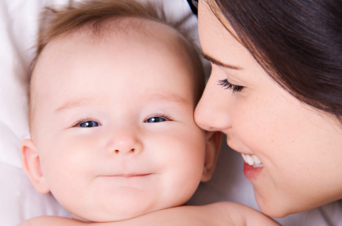
The “ideal” time
Me : 25- 30 years
1st : 24 years
2nd : 22 years
3rd : 26 years
4th : 25 years

Slide 4
What would you feel & do if you could not conceive a child?
In Vitro Fertilization
Adoption
Surrogate
Motherhood
Artificial
Insemination
I would feel horrible, like I’m not being a good wife. I would probably try artificial insemination first, and if that didn’t work I would just adopt.
1st : “If I couldn’t have kids I would feel bad, but I don’t want kids of my own anyways. I would love to adopt or artificial insemination.”
2nd: “If I couldn’t have kids I would be very angry because I love kids and that is what I’m looking forward to when I’m older. If I couldn’t have kids I would do artificial insemination. If that didn’t work I would adopt.”
3rd: ”I would feel sad and desperate for a child. I would adopt a child and in the future try insemination.”
4th:“Depressed and alone. And I would adopt only.”

Slide 5
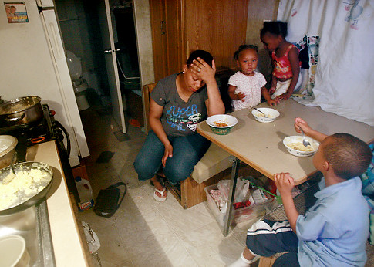
How do you feel about poor people not having these options?
I think if they can’t afford to get the process of having a child. Then they really don’t have the ability to provide for a stable life for the kid in the future.

Slide 6
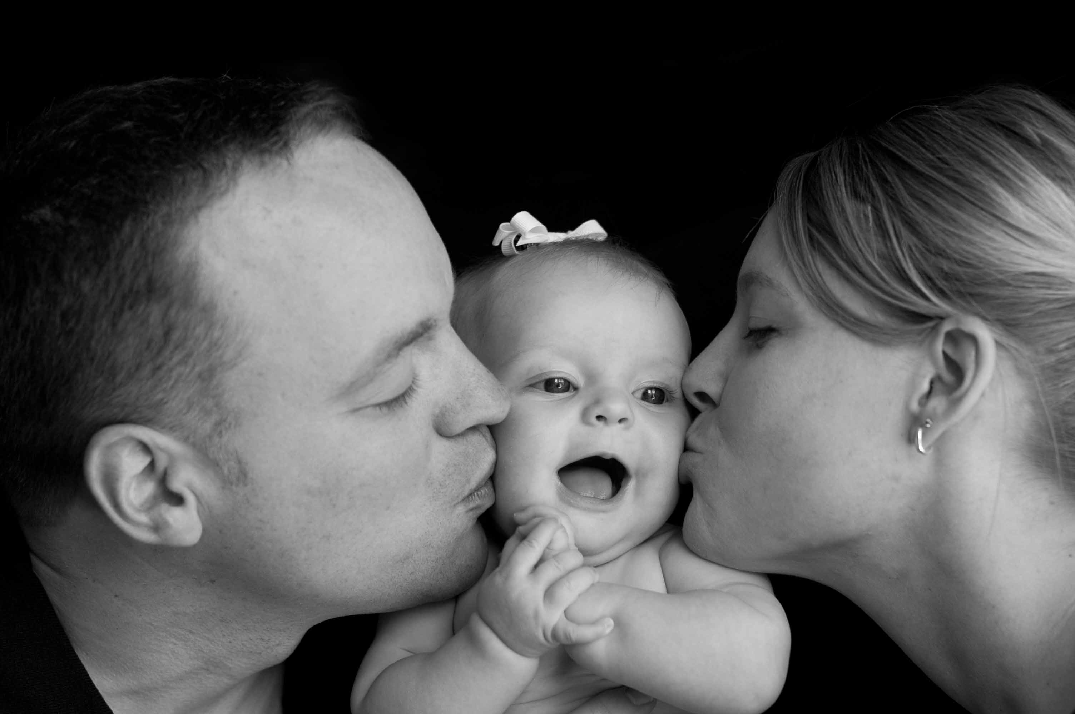
The End

